Slide 1
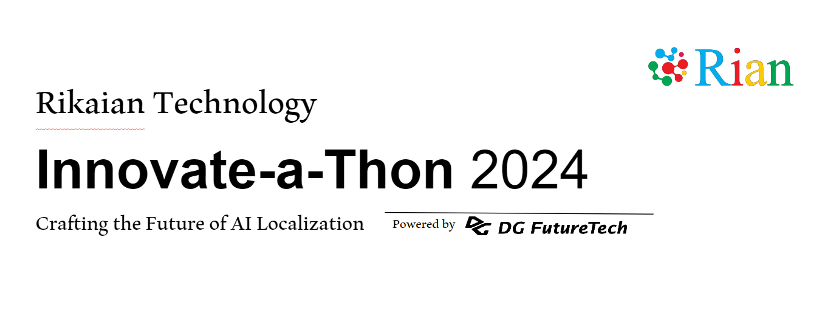
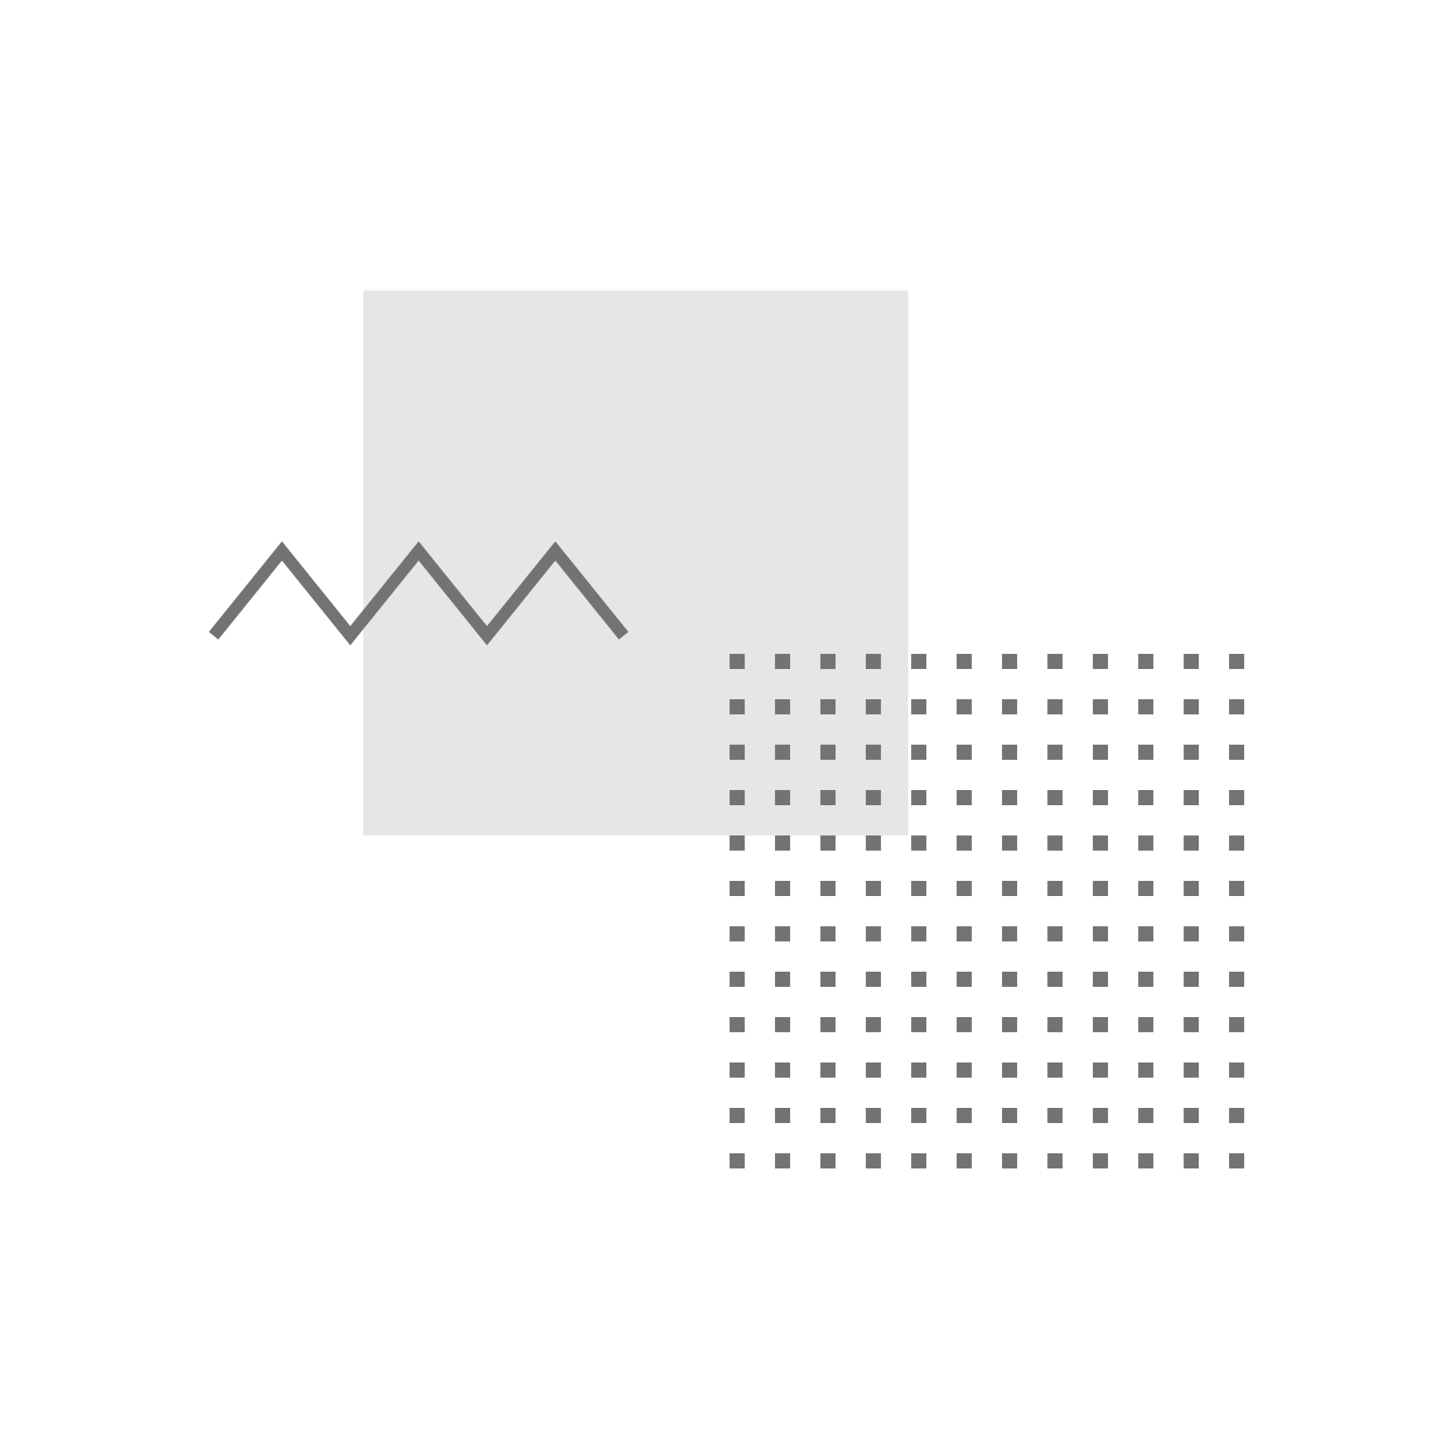
Details
Mubashir Salim
Christ University Pune
Real-Time Multi-Language Video Annotations

Slide 2
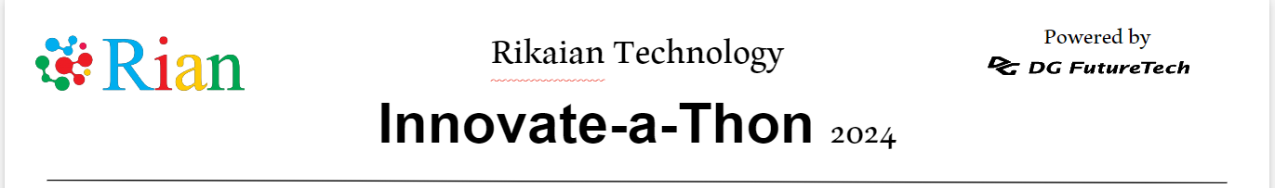
The project aims to develop a platform that enables real-time annotations on videos in multiple languages. This platform allows users to add text, shapes, or comments to a video while it is playing. These annotations are instantly translated and displayed in the user's preferred language, ensuring accessibility and understanding for a global audience.
Brief about the idea

Slide 3
Opportunities:
(a): Differentiation:
Combines real-time annotations and translations in one platform.
Unlike existing tools, it integrates both functionalities seamlessly.
(b): Problem-Solving:
Enhances accessibility and understanding by allowing real-time, multi-language engagement with video content.
(c): USP:
Real-time video processing, annotation, and multi-language translation in one interface.
User-friendly and scalable across various industries.

Slide 4
List of features offered by the solution:
Real-Time Video Annotations: Draw shapes, add text, and comments directly on videos.
Multi-Language Support: Annotations are automatically translated into multiple languages based on user preferences.
User Interface: Intuitive UI for easy annotation with tools for drawing, text, and comments.
Real-Time Processing: Instant updates to annotations during video playback without delays.
Localization: Seamless integration with Google Translate API for accurate and context-aware translations.
Customizable Annotations: Options to change font size, color, and shape properties.

Slide 5
Process flow diagram or Use-case diagram:
Process Flow Diagram:
[Start]
[User Uploads Video]
[Video Playback]
[Annotation Selection]
[Add Annotations]
[Real-Time Translation]
[Display Translated Annotations]
[Save/Export]
Use-Case Diagram:
[User]
[System]
[Upload Video]
[Annotate Video ]
[Translate Annotations]
[Display Translations]
[Save Video ]

Slide 6
Architecture diagram of the proposed solution:
User Interface (UI)
Video Upload
Annotation Tools
Language Selection
Video Player (Video.js)
Load and Play Video
Display Annotations
Handle User Interaction
WebSocket Server
Real-Time Communication
Annotation Processing
Process User Annotations
Coordinate with Video
Apply Annotations
Translation Service
Google Translate API
Translate Text
Localization
Database
Store Annotations
User Preferences
Video Metadata

Slide 7
Technologies to be used in the solution:
1. Frontend:
HTML5 & CSS3
JavaScript
Video.js
HTML5 Canvas/SVG
WebSocket
3. Deployment:
Google Cloud Platform
4. Development Tools:
VS Code
Git & GitHub
Npm
2. Backend:
Node.js
WebSocket Server
Google Translate API

Slide 8
Snapshots of the prototype

Slide 9
Thank You!!

